Slide 1
Matrix Algebra
2.2 The Inverse of a Matrix
Bumhee Cho

Slide 2
Multiplicative Inverse of a Number
3
3⁻¹
3⋅3⁻¹ = 1
3⁻¹⋅3 = 1

Slide 3
Invertible Matrix
An n × n matrix A is said to be invertible if there is an n × n matrix C such that
CA = I and AC = I
B = BI = B(AC) = (BA)C = IC = C
A⁻¹A = I and AA⁻¹ = I
a nonsingular matrix: invertible
a singular matrix: not invertible

Slide 4

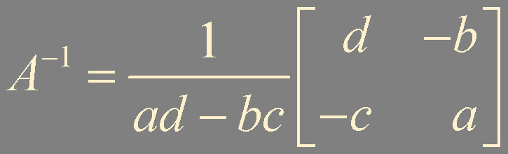
Theorem 4.
Let A = . If ad - bc ≠ 0, then A is invertible and
det A = ad - bc

Slide 5
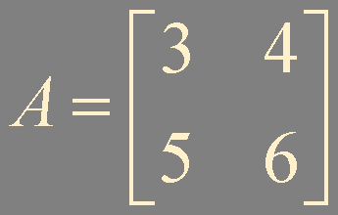
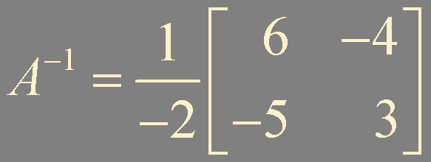
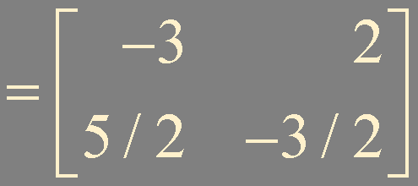

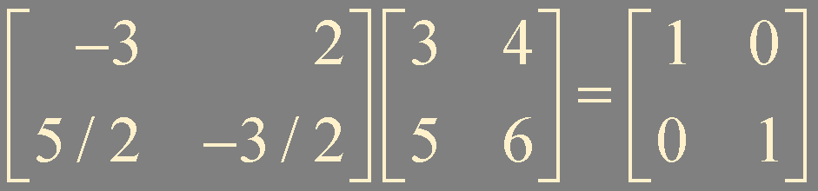
Example 1.

Slide 6
Theorem 5.
Let A is an invertible n × n matrix, then for each b in ℝ^{n},
the equation Ax = b has the unique solution x = A⁻¹b
Au = b
A⁻¹Au =A⁻¹ b
I_{n}u = u =A⁻¹ b

Slide 7
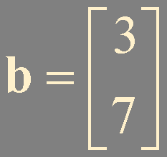

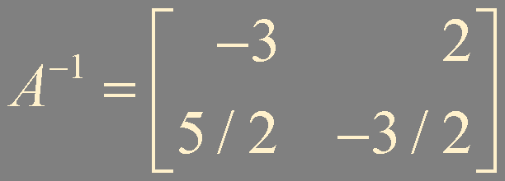
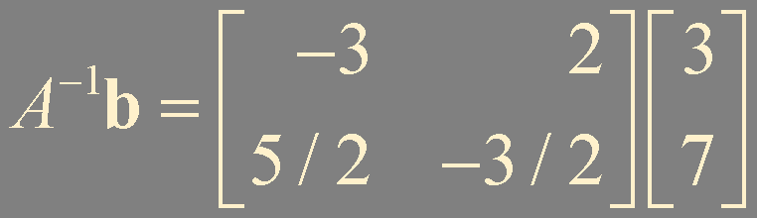
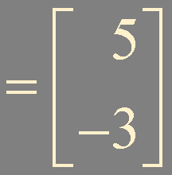
Example 2.

Slide 8
Theorem 6.
If A is an invertible matrix, then A⁻¹ is invertible and
(A⁻¹)⁻¹ = A
If A and B are n × n invertible matrices, then so is AB, and the inverse of AB is the product of the inverses of A and B in the reverse order. That is,
(AB)⁻¹ = B⁻¹A⁻¹
If A is an invertible matrix, then so is A^{T}, and the inverse of A^{T} is the transpose of A⁻¹. That is,
(A^{T})⁻¹ = (A⁻¹)^{T}
(A⁻¹)^{T}A^{T} = (AA⁻¹)^{T} = I^{T} = I

Slide 9
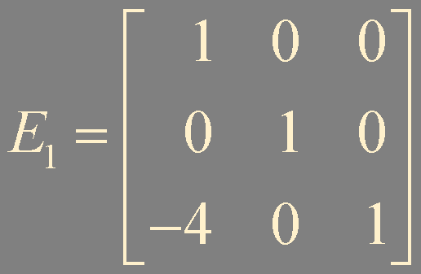
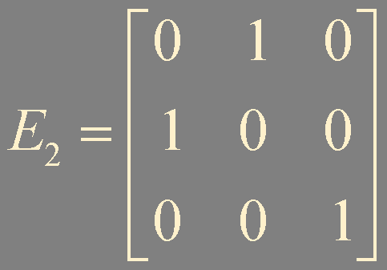
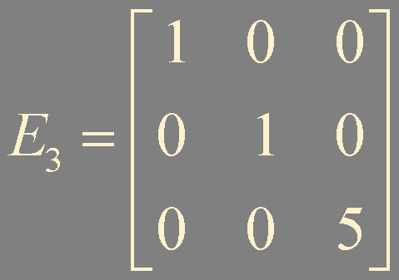
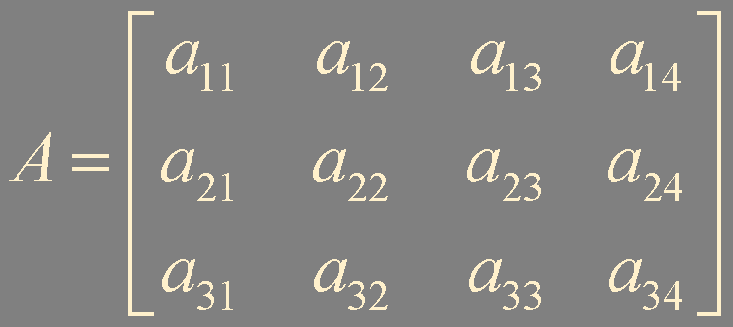
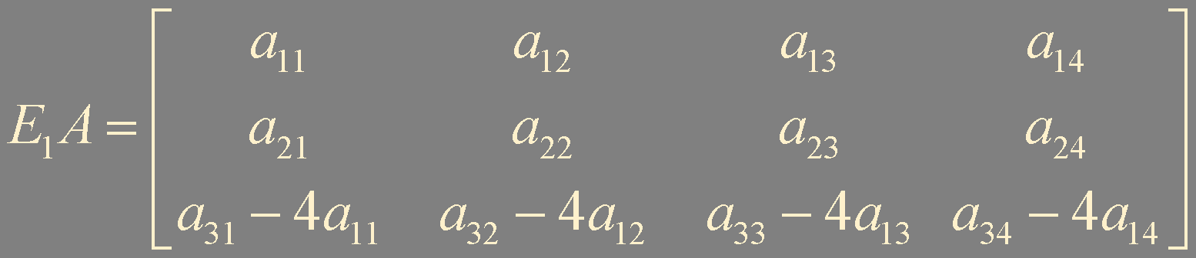
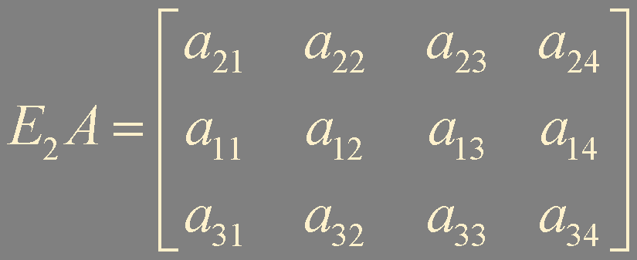
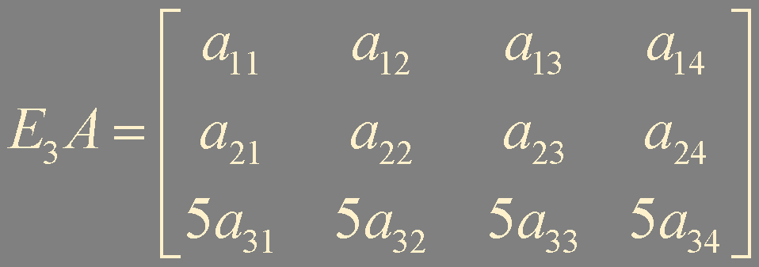
Elementary Matrices
An elementary matrix is one that is obtained by performing a single elementary row operation on an identity matrix

Slide 10
If an elementary row operation is performed on an m × n matrix A,
the resulting matrix can be written as EA, where the m × m matrix E is created by performing the same row operation on I_{m}
Each elementary matrix E is invertible. The inverse of E is the elementary matrix of the same type that transforms E back into I.

Slide 11
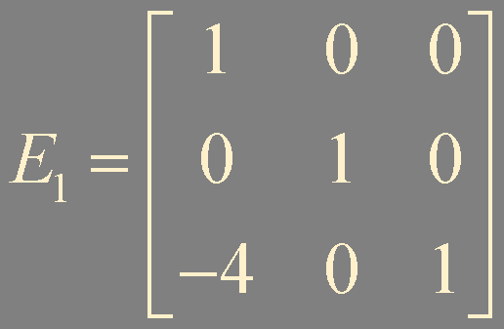
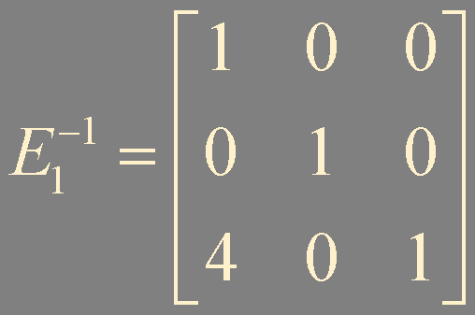
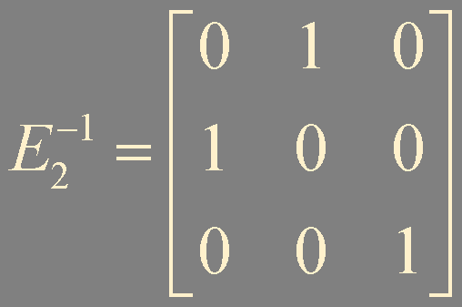
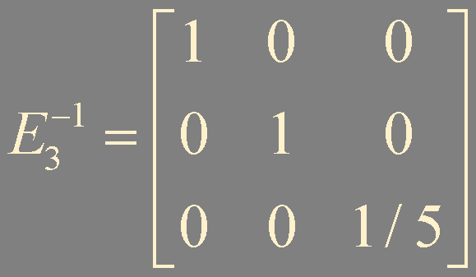
Example 2.

Slide 12


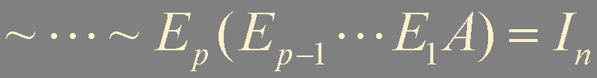
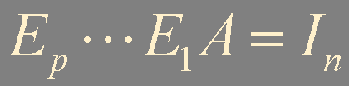

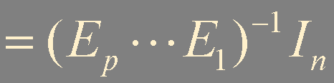
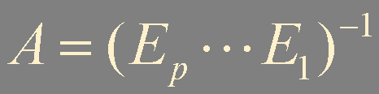

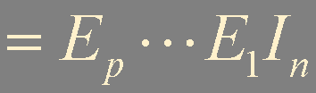
Theorem 7.
An n × n matrix A is invertible if and only if A is row equivalent to I_{n}, and in this case,
any sequence of elementary row operations that reduces A to I_{n} also transforms I_{n} into A⁻¹

Slide 13



Algorithm for Finding A⁻¹

Slide 14
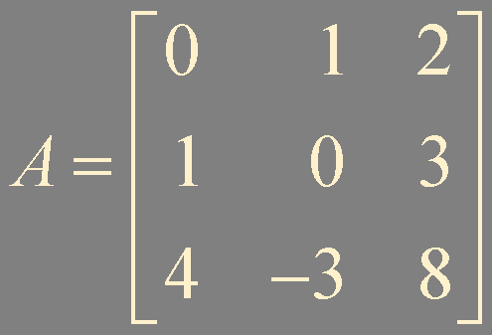
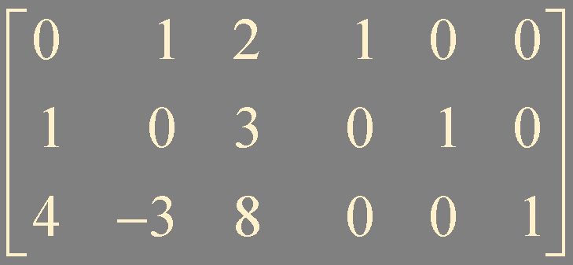
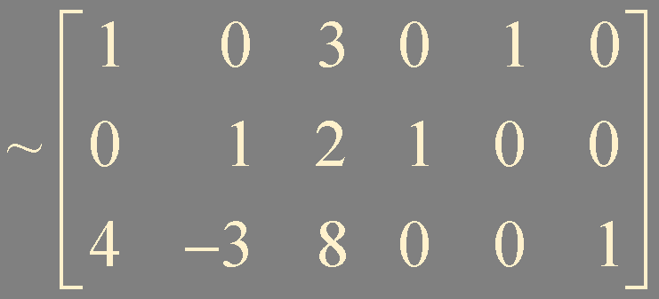
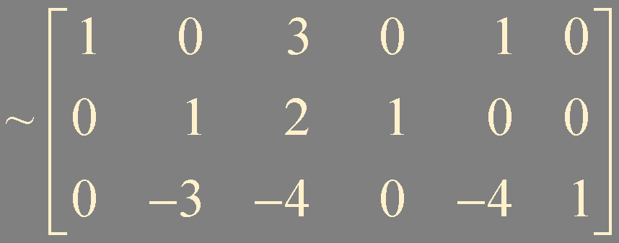
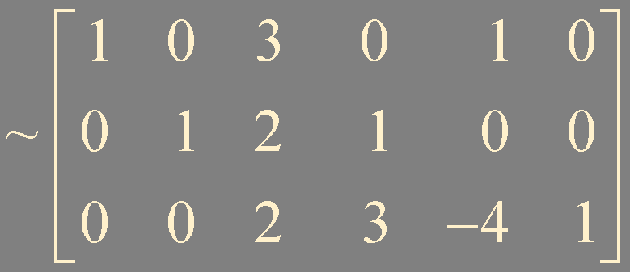
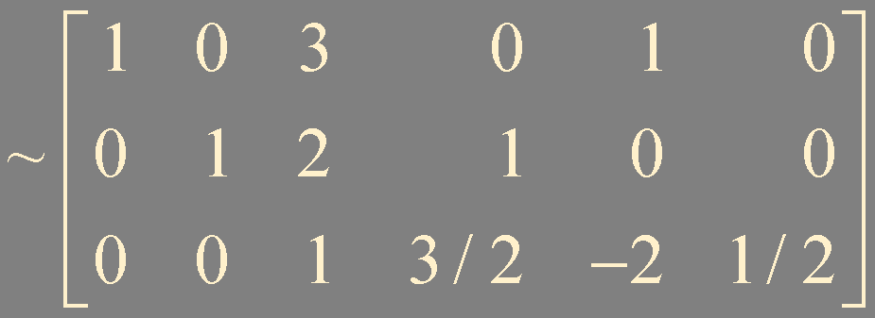
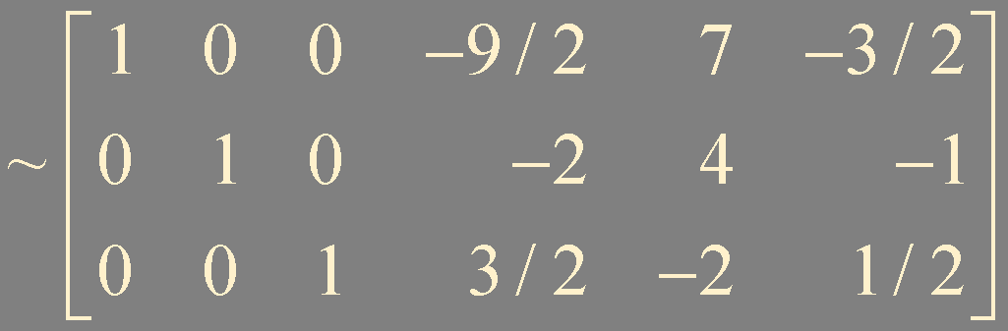
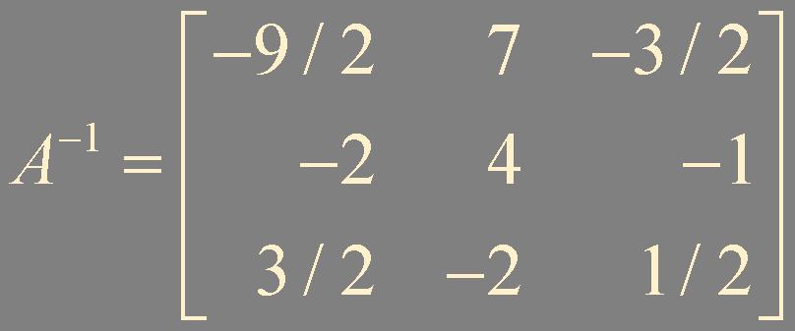
Example 3.
A
I

Slide 15




Another View of Matrix Inversion

Slide 16
Summary
Invertible matrix
Elementary matrices
Algorithm for finding A⁻¹

